Slide 1



Confucius
“The man who says he can and the man who says he can’t are both correct”
Presentation:王岳
Translation：董自经
Manuscript：杨文莉
PowerPoint：林小词，周正宜

Slide 2
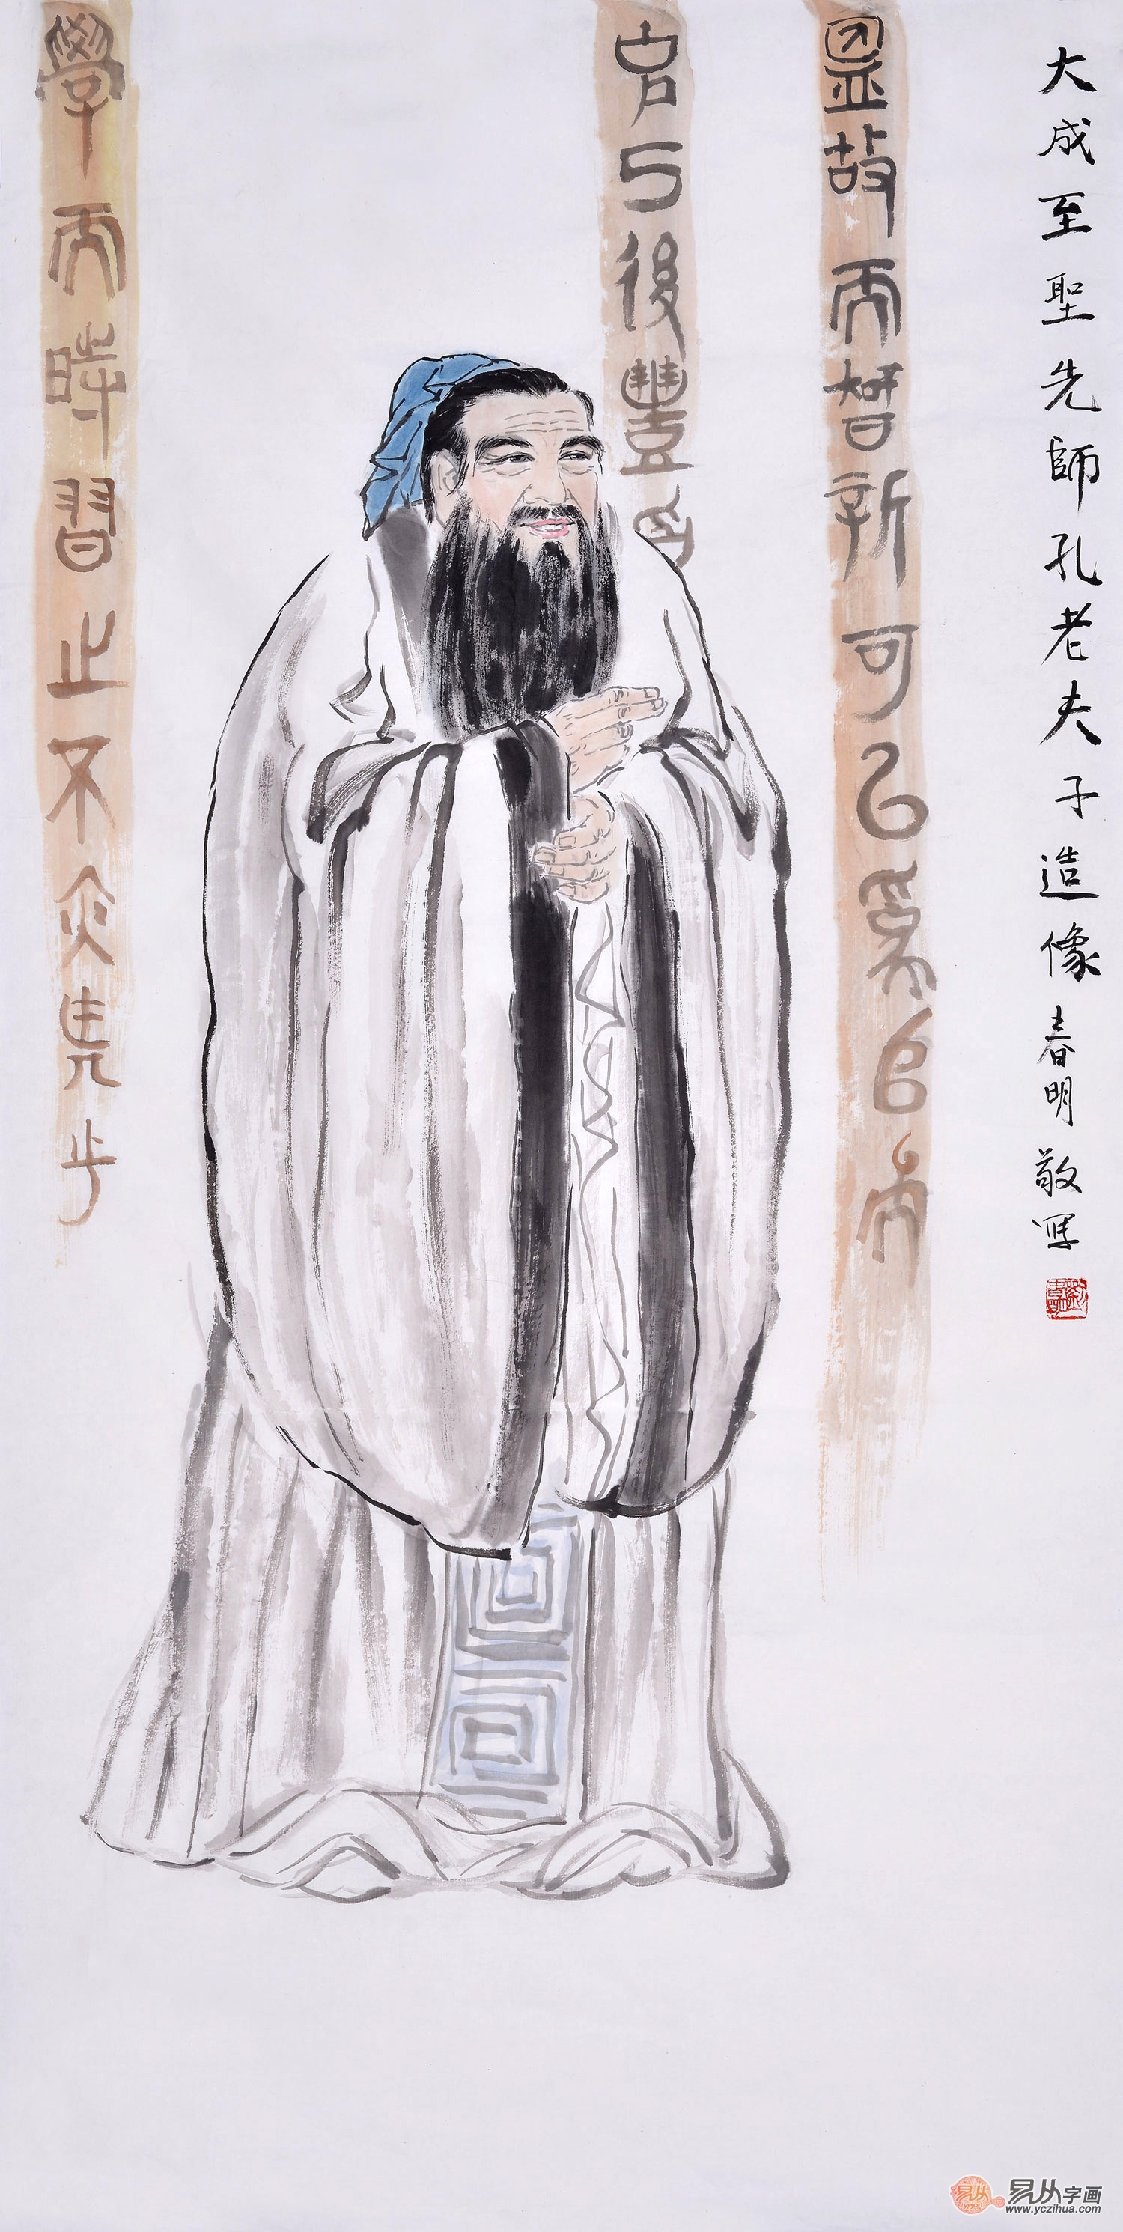

The man who says he can and the man who says he can’t are both correct.
知之为知之，不知为不知，是知也

Slide 3
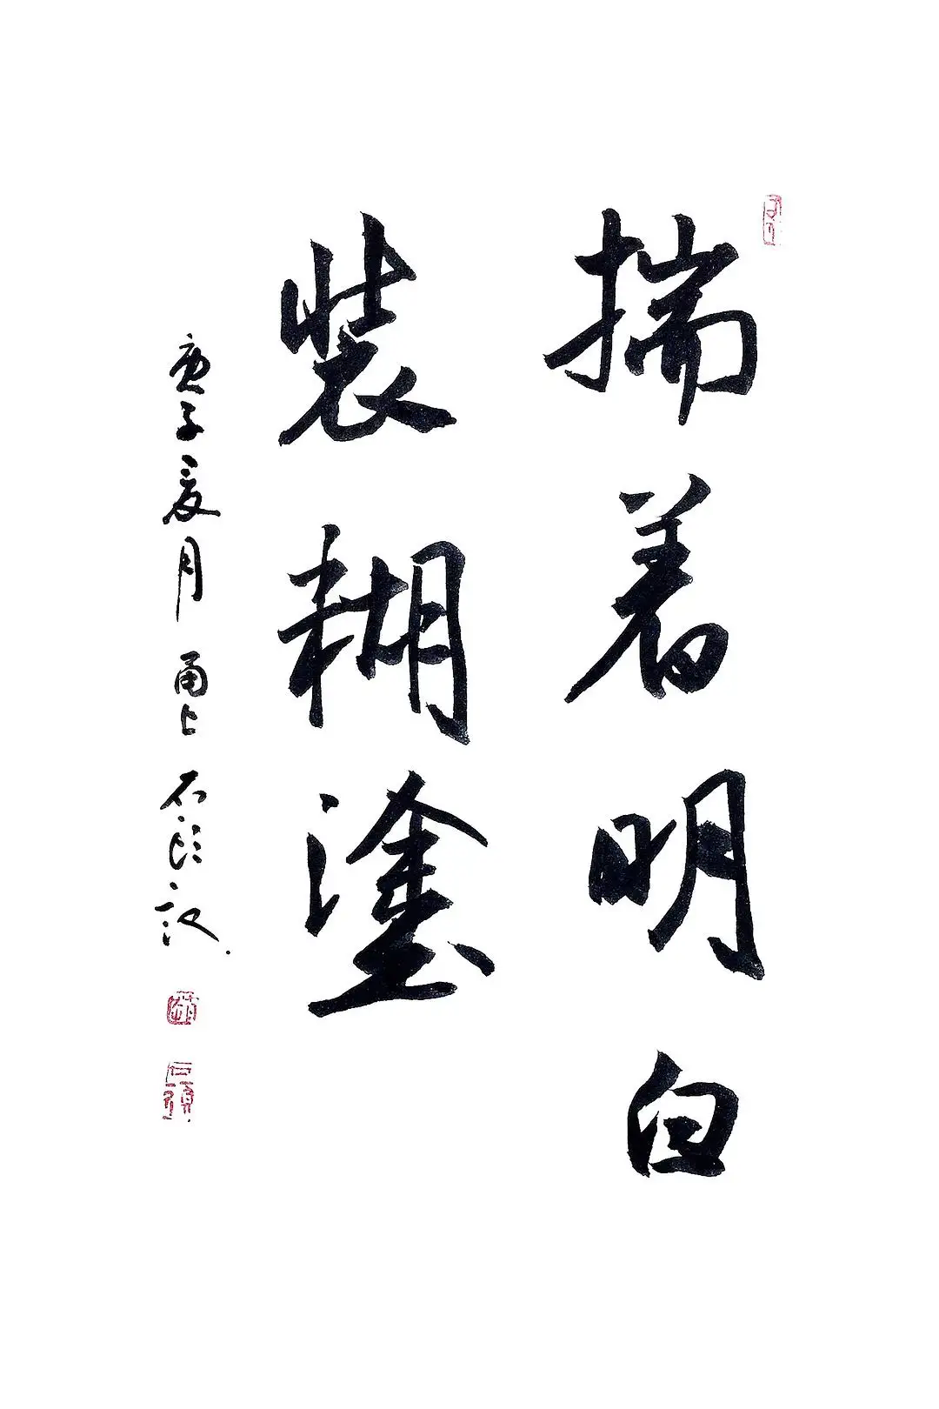
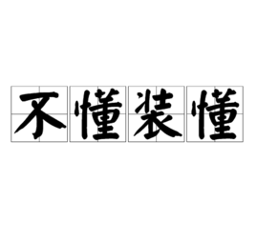
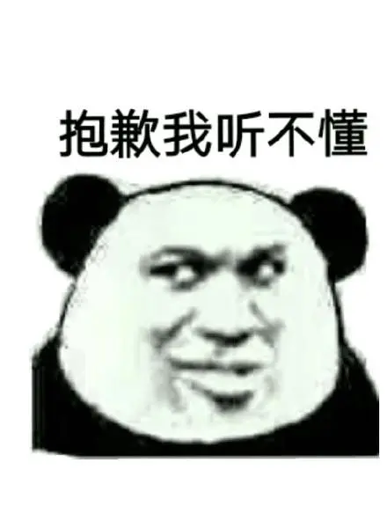
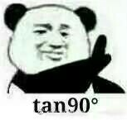

Slide 4
Lose the opportunity to learn
Not be able to go further

Slide 5
Honest
Correct
reasonable
appropriate

Slide 6

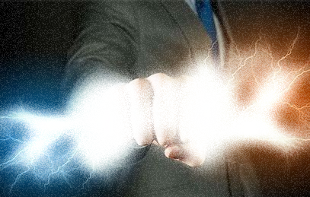

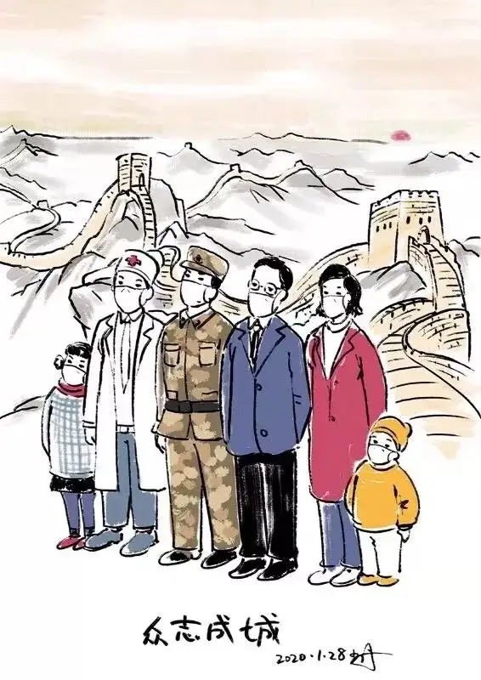
Knowledge
Opportunity
01
02
Us College Student
Sharing
Society
03
04

Slide 7
Thanks for listening
Group two

